Slide 1
QA Practical project musiconnect
Oliver stockman

Slide 2
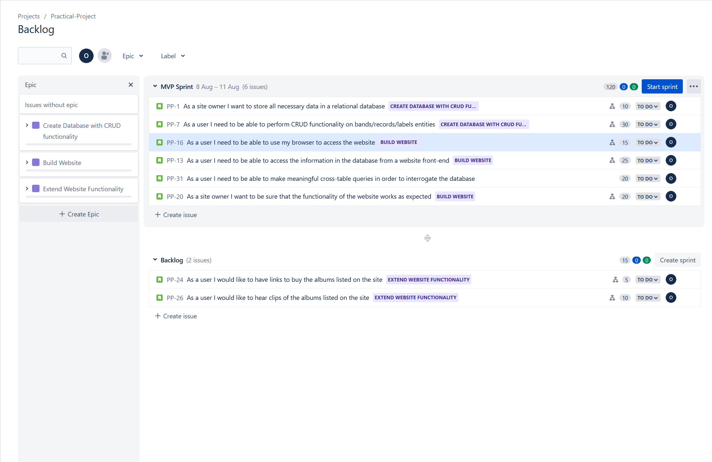
jira

Slide 3
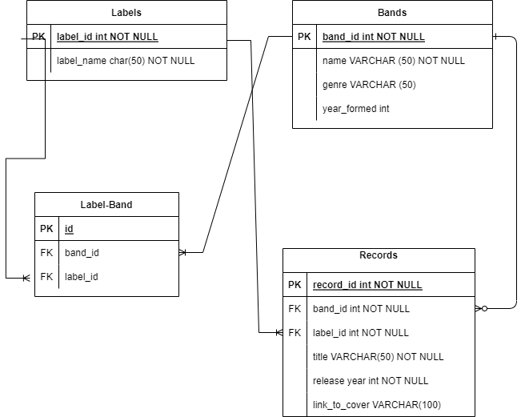
Design – erds v1

Slide 4
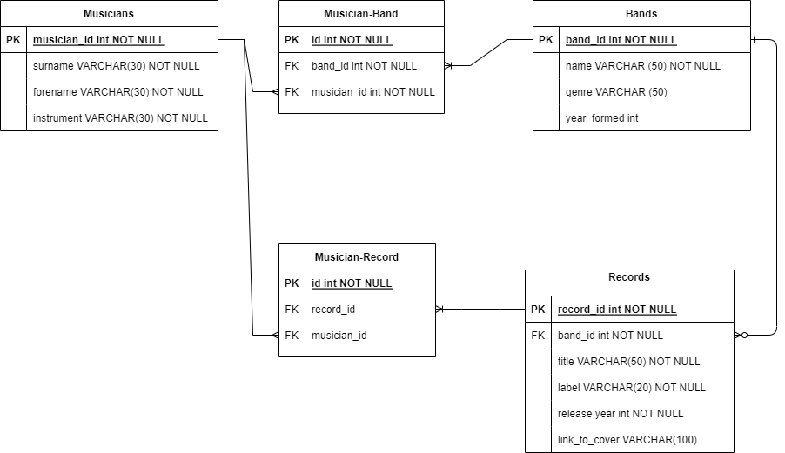
Design – erds v2

Slide 5
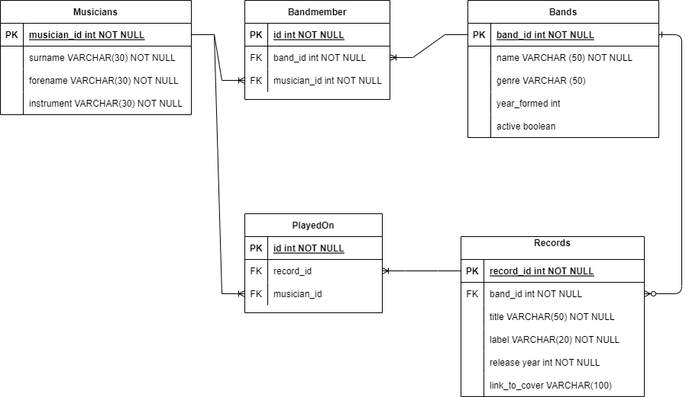
Design – erds v2.1

Slide 6
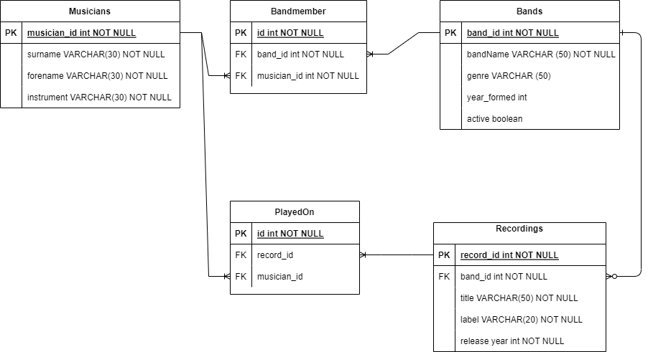
Design – erds v2.2

Slide 7
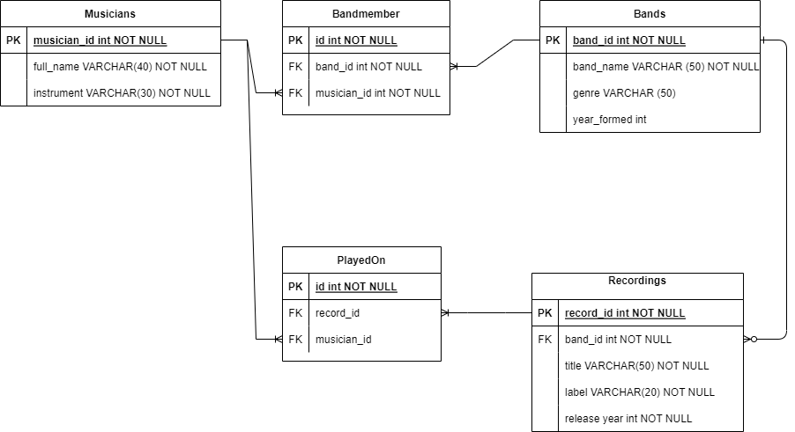
Design – erds v2.3

Slide 8
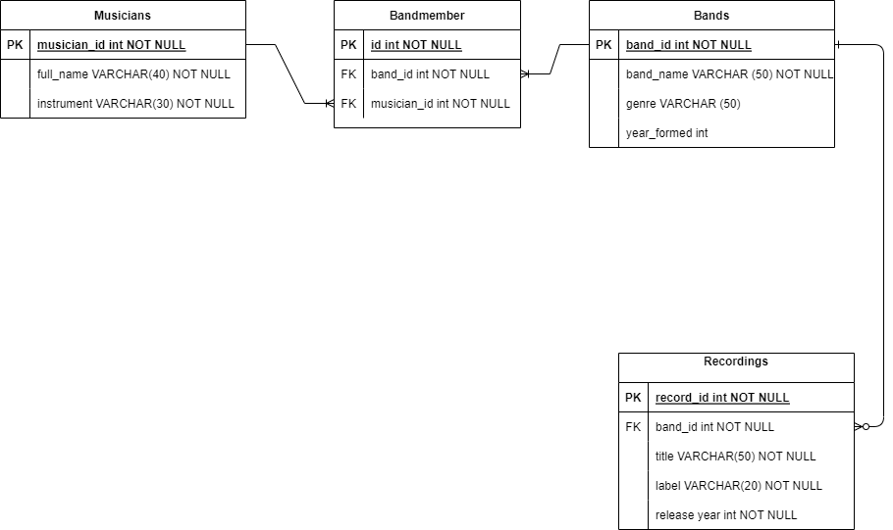
Design – erds v2.4

Slide 9
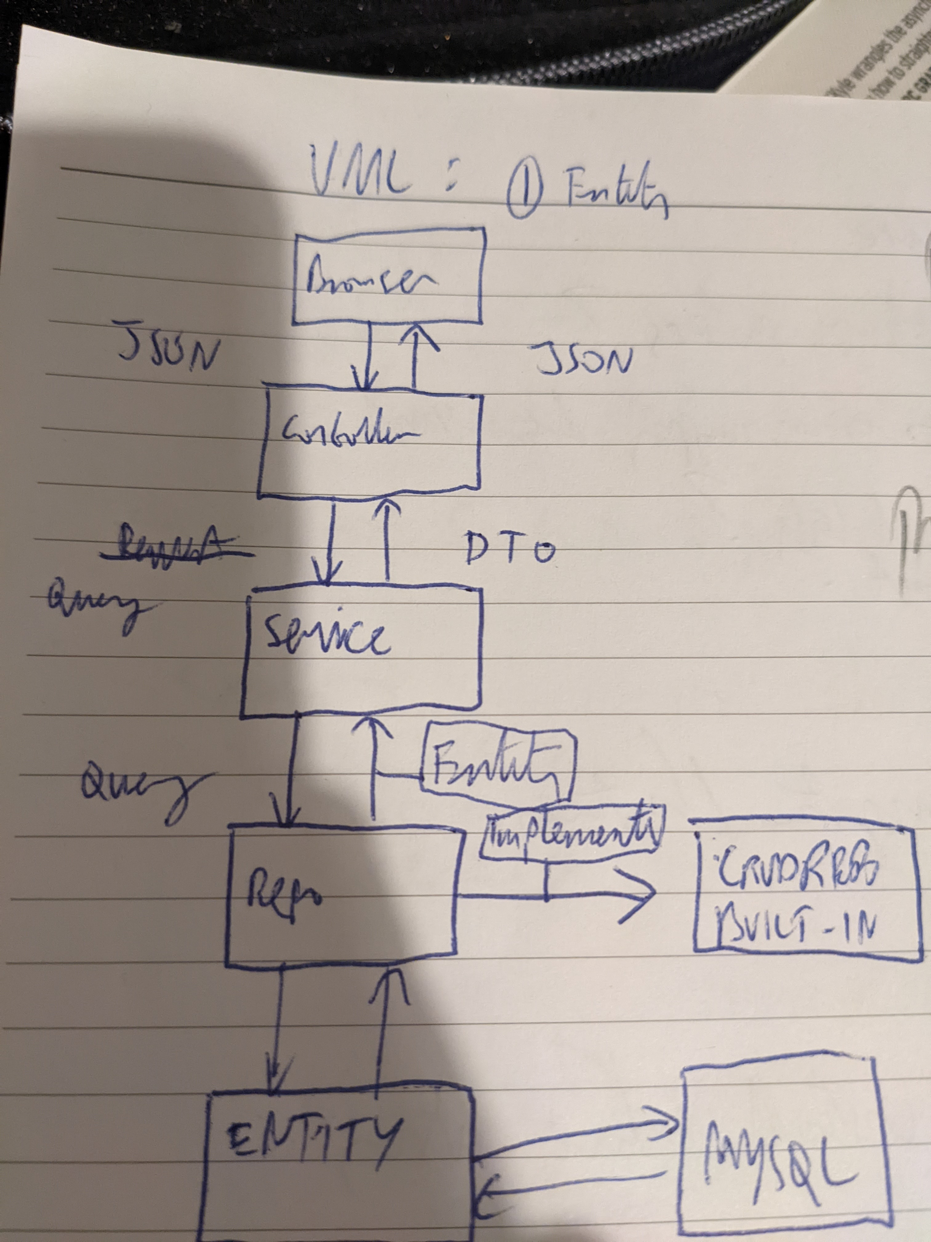
Design – uml

Slide 10
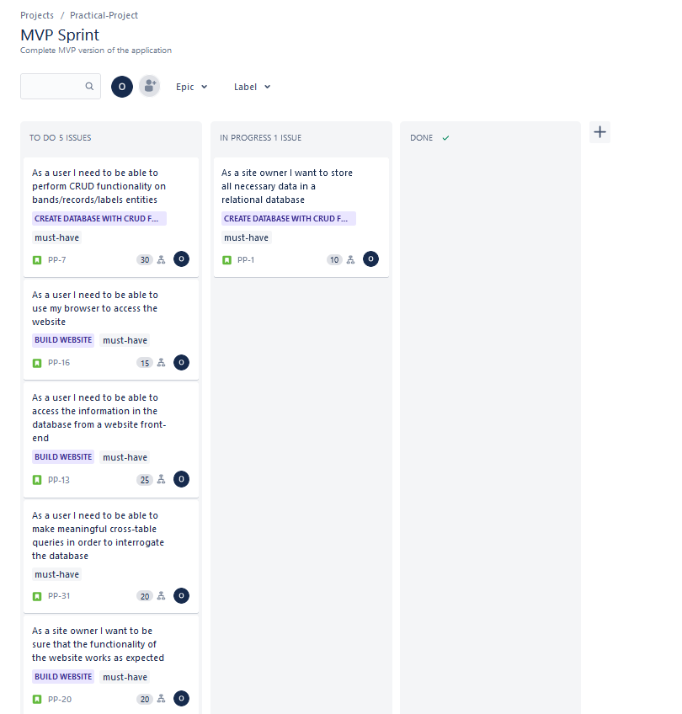
Progress tracking - start

Slide 11
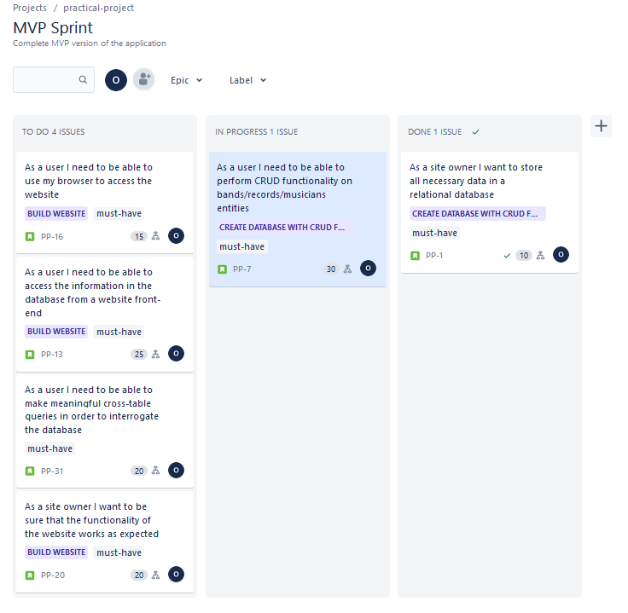
Progress tracking – in progress

Slide 12
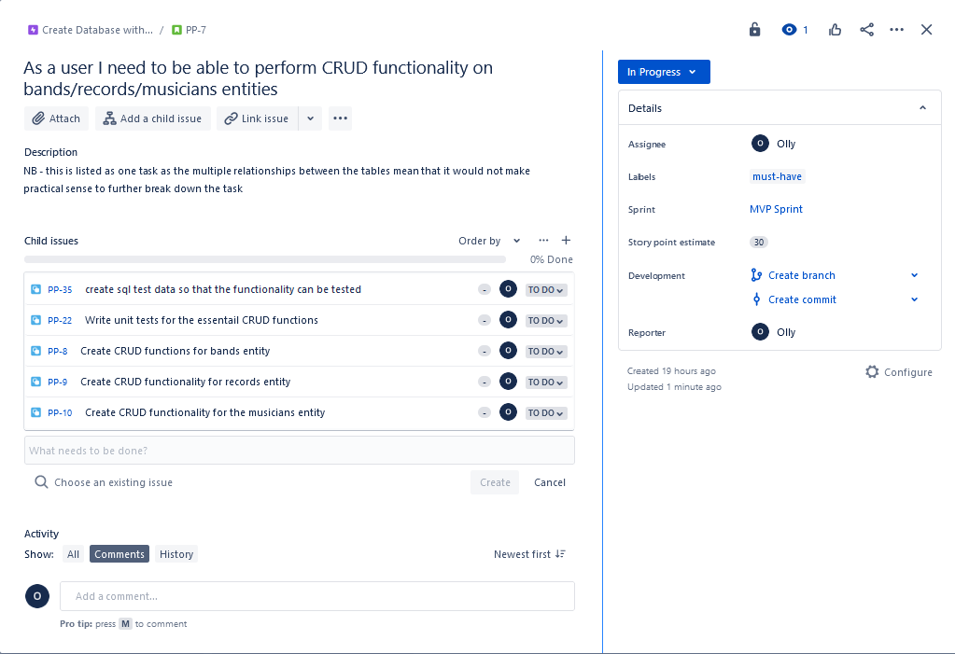
Progress tracking – in progress 2

Slide 13
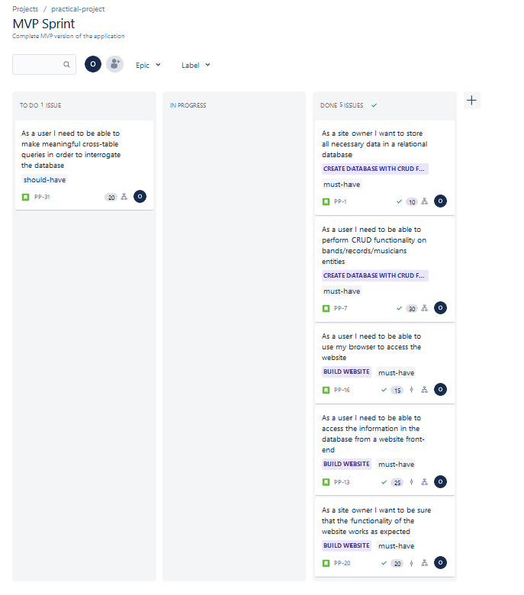
Progress tracking – final

Slide 14
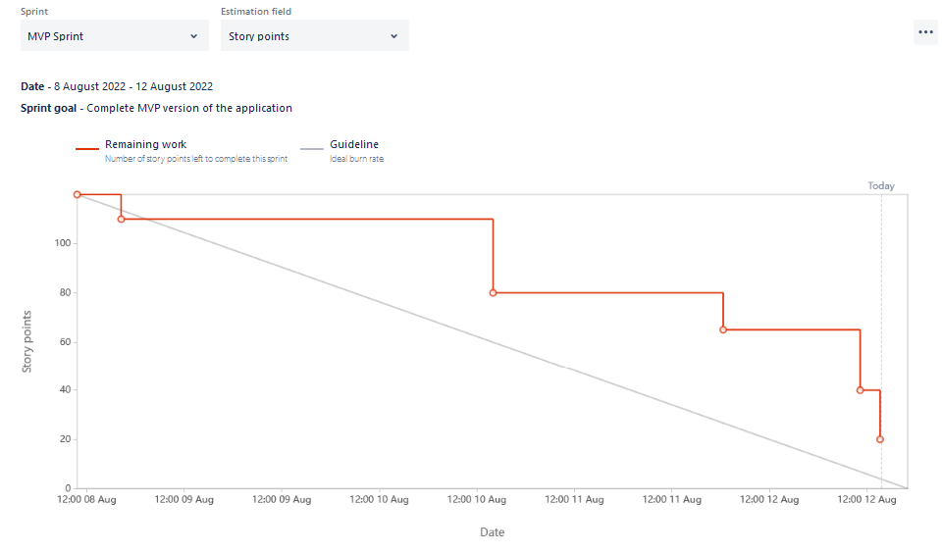
Burn down - final

Slide 15
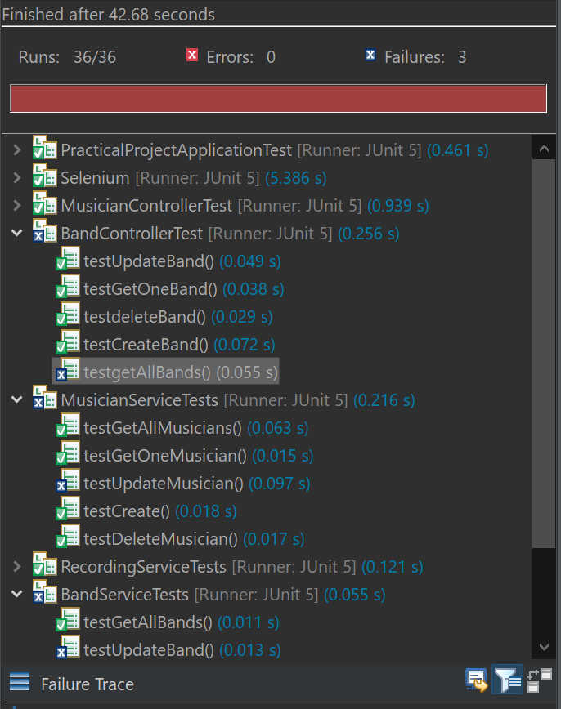

testing

Slide 16
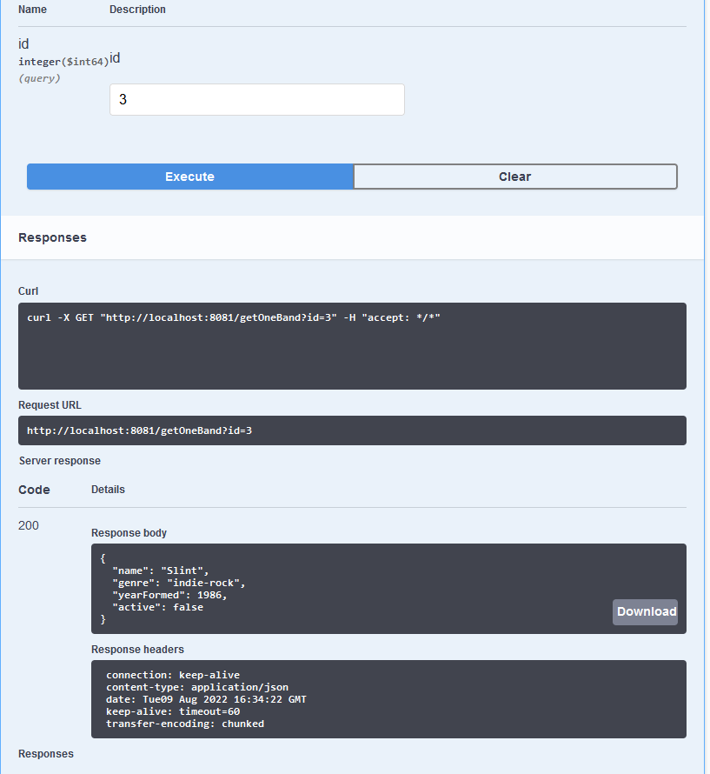
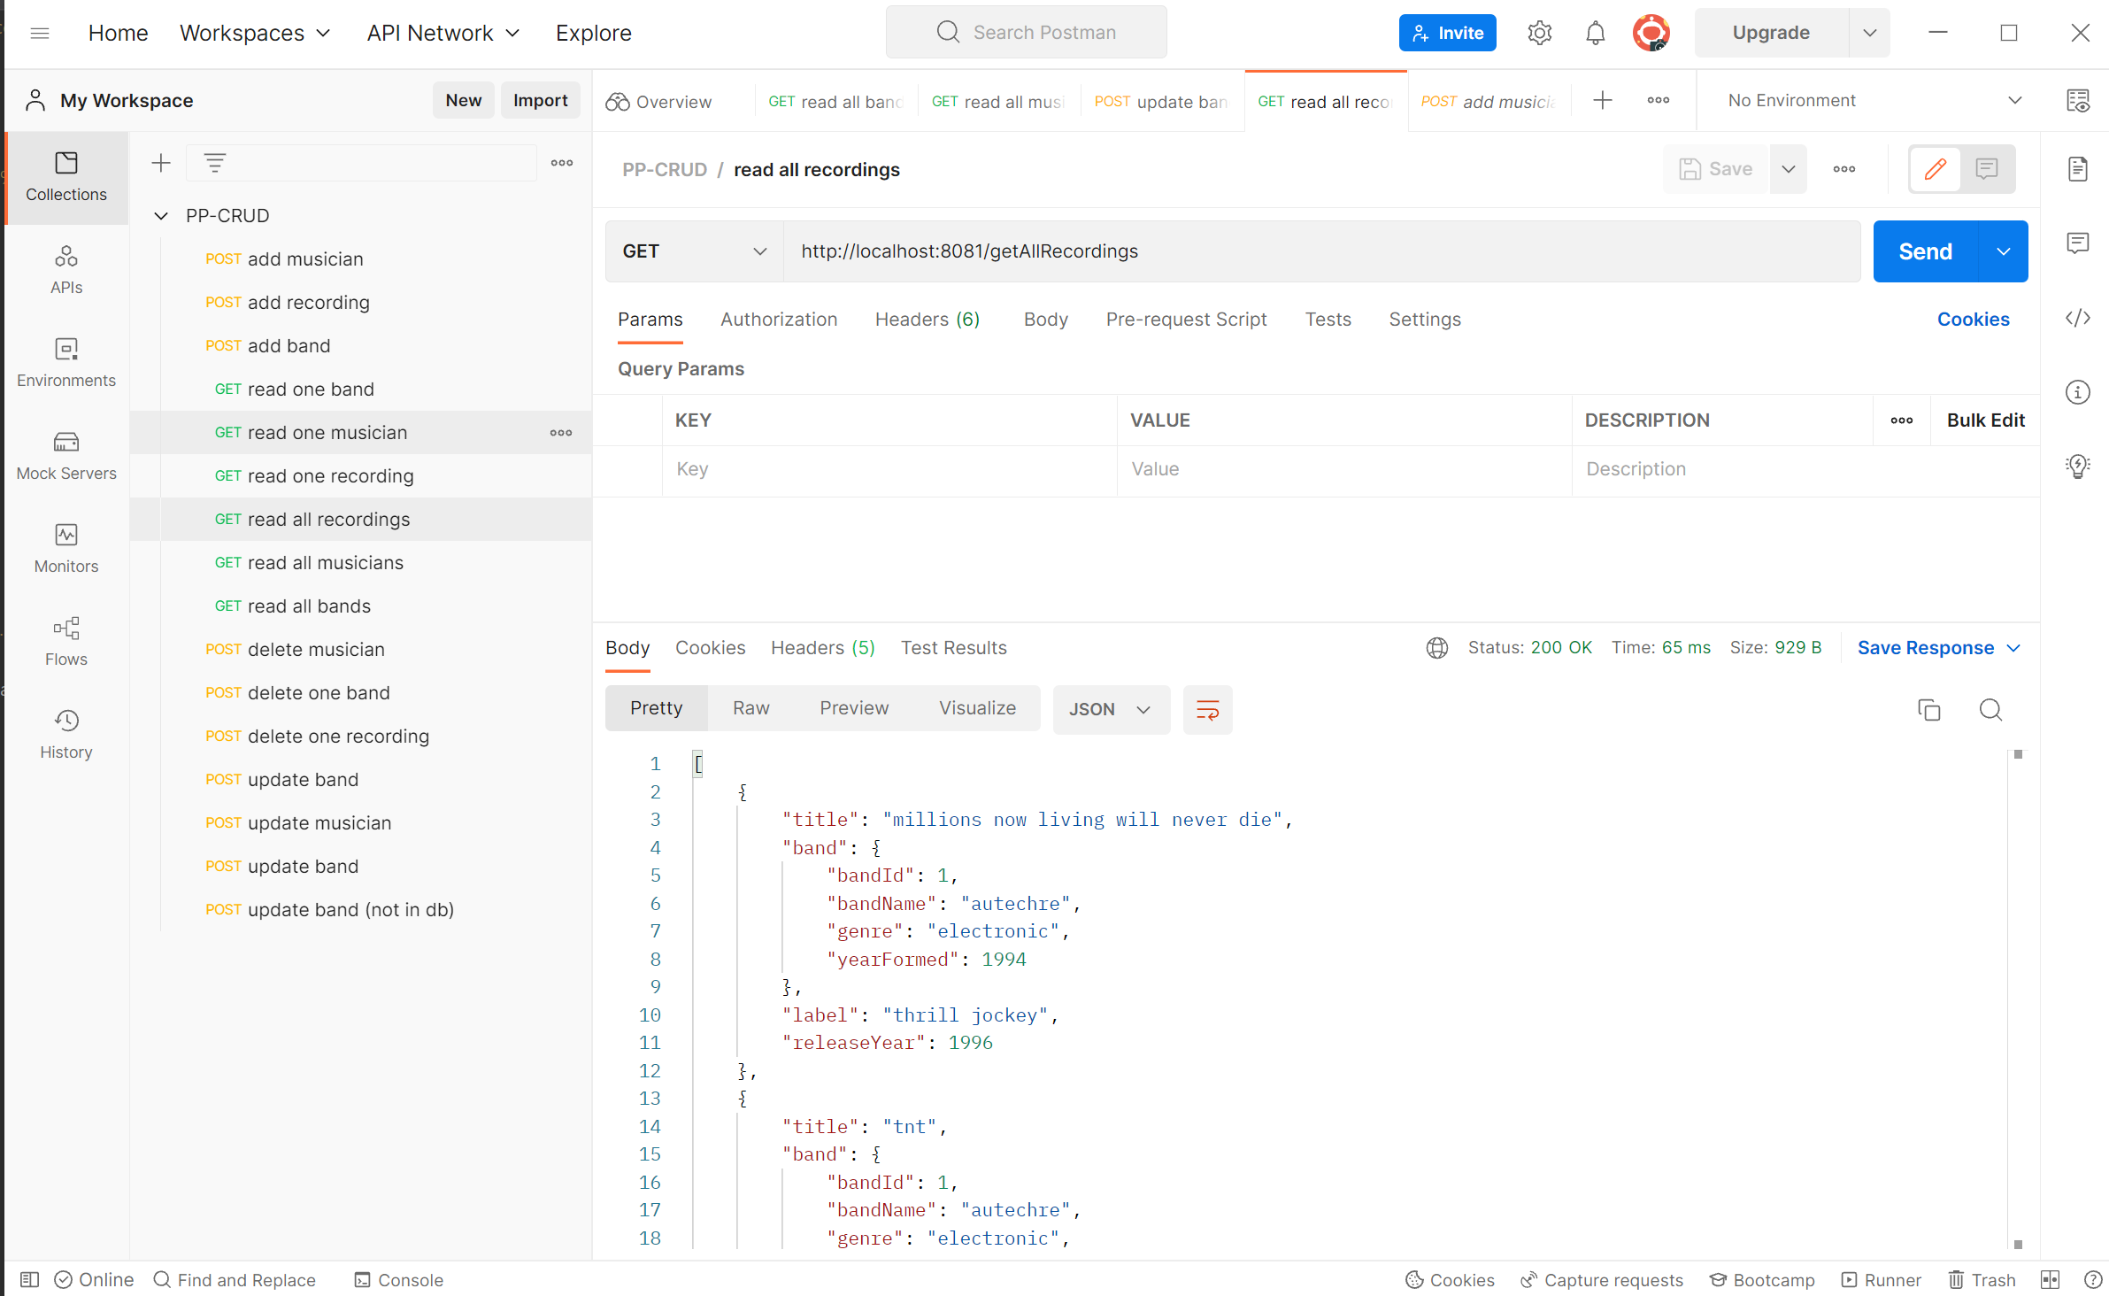
Swagger vs postman

Slide 17
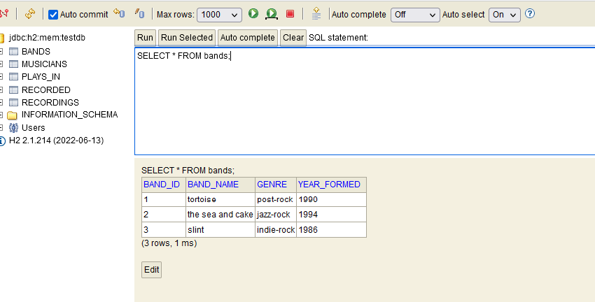
H2 console

Slide 18
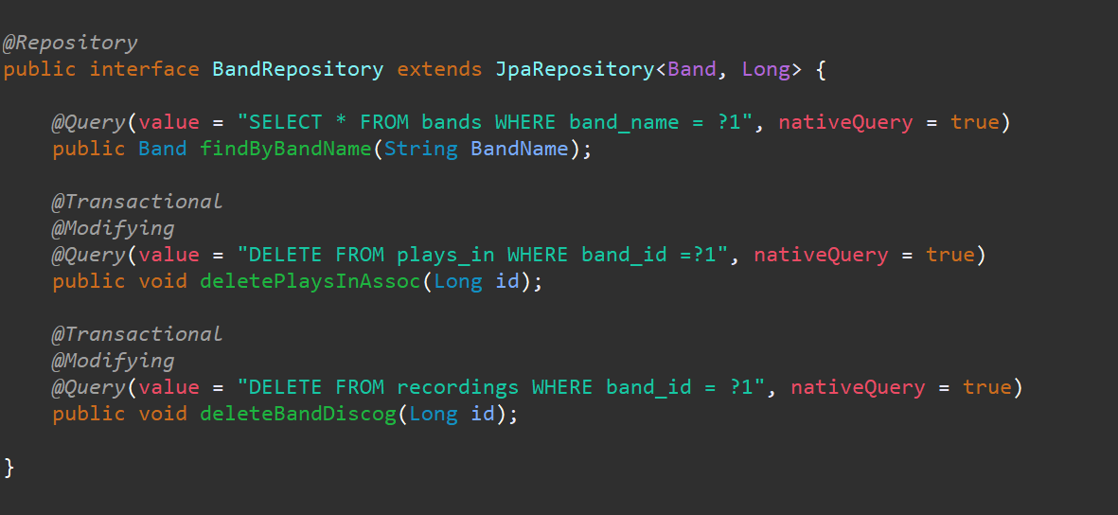
Some custom queries…

Slide 19

Any questions?

